Slide 1


Thrive in chaos
Dotnet Friday
Martijn van Arkel
18th of September

Slide 2



Martijn van Arkel
.NET Developer

Slide 3

We all try to build reliable systems
Notes:
Scalable
Self recovering
Scalable
Self recovering
High Availability
Load Balancing
Fault Tolerance
Sharding
Event-Driven Architecture

Slide 4
Then the inevitable happens
at 3:00 AM
Notes:
Scalable
Self recovering

Slide 5
Are you sure they work as designed in production
Notes:
Misconfiguration
Broken code deployed
Unexpected spike in load
Resources not scaled correctly
External service unavailable
Azure outage

Slide 6
This is where
chaos engineering
can help
Notes:
Misconfiguration
Broken code deployed
Unexpected spike in load
Resources not scaled correctly
External service unavailable
Azure outage

Slide 7
Let’s start with some history

Slide 8

Apple 1983
Steve Capps developed Monkey to test MacWrite and MacPaint.
Notes:
Monkey rapidly generates/sends random user interface inputs.

Slide 9
Prologue 1992
Iain James Marshall developed ‘La Matraque’
Generates valid and invalid graphical interface events at high speed.
Notes:
La Matraque:
- Generates valid and invalid graphical interface events at high speed;
- Would test for days on end prior to production delivery

Slide 10

Amazon 2003
Jesse Robins(aka ‘Master of Disaster’)
Created a program called ‘GameDay’. During GameDay real incidents are simulated.
Notes:
deliberately injecting failures in production systems
Approach from firefighting

Slide 11

Google 2006
Kripa Krishnan created ‘DiRT’(Disaster Recovery Testing)
Similar too GameDay real incidents are simulate

Slide 12
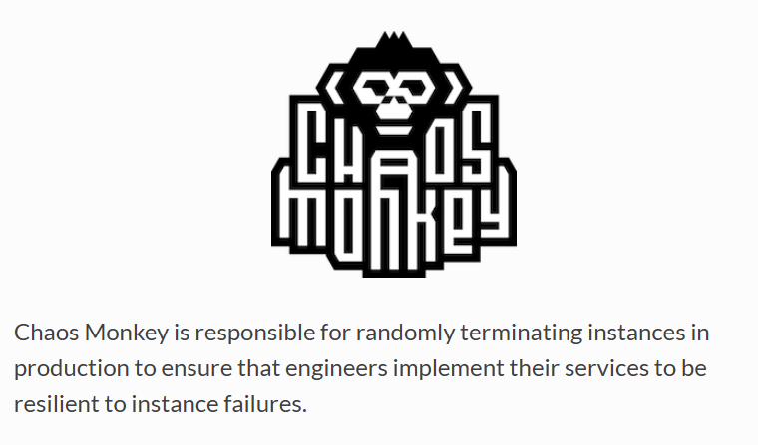
Netflix - 2011
Chaos Monkey: Takes down random instances
Chaos Kong: Takes down an entire service
Chaos Gorilla: Takes down an entire AWS region
Notes:
Source: https://youtu.be/ZBk8oCmfpMg?si=0tcwlUtA1Fx-aidi&t=1404

Slide 13
Chaos engineering is just turning off random things?

Slide 14

Notes:
Misconfiguration
Broken code deployed
Unexpected spike in load
Resources not scaled correctly
External service unavailable
Azure outage

Slide 15
“Chaos engineering is the practice of intentionally injecting faults into a system to test its resilience. The goal is to identify potential failure points and correct them before they cause an actual outage or other disruption.”
Source: https://www.opentext.com/what-is/chaos-engineering#:~:text=Chaos%20engineering%20is%20the%20practice,actual%20outage%20or%20other%20disruption
“Chaos Engineering is the discipline of experimenting on a system in order to build confidence in the system’s capability to withstand turbulent conditions in production.”
Source: https://principlesofchaos.org/

Slide 16
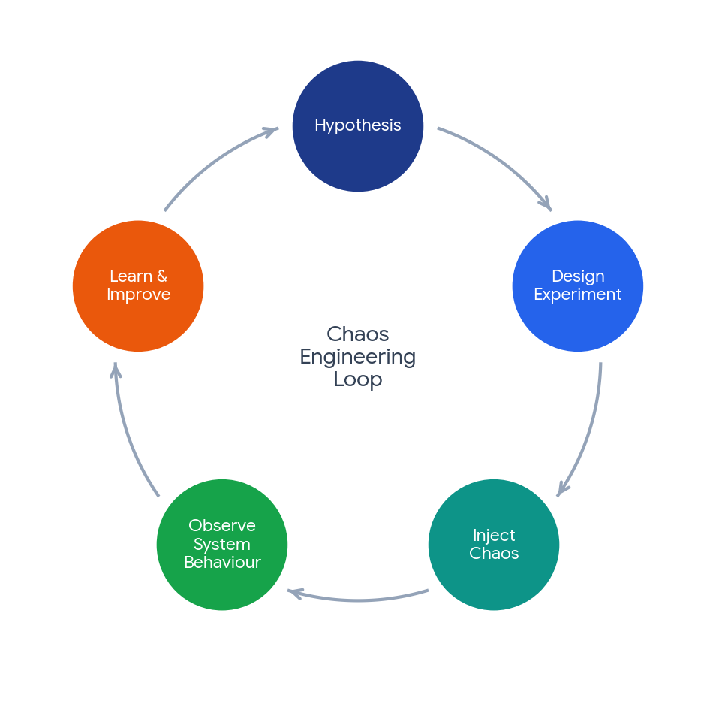
Instead create experiments

Slide 17
Instead create experiments
Hypothesis
Learn and make improve
Design
experiment
Observe system behaviour
Inject chaos

Slide 18

Where to run experiments

Slide 19
What could a minimal experiment be?

Slide 20
Example experiment
Context:
Online system the buy concert tickets
Fault injected:
The invoicing service has an outage
Success conditions:
- When the service is back online every invoice is sent
- No duplicate invoices are sent

Slide 21
Example experiment
Context:
Online system the buy concert tickets
Hosted in West Europe and North Europe
Fault injected:
Service to buy tickets has an outage in West Europe
Success conditions:
- All requests are redirected to North Europe
- At least 95% of requests are successful
- At least 95% of requests complete within 1 second

Slide 22
Tools in Azure
Azure Chaos Studio
Azure load testing
Notes:
Workspaces

Slide 23
Risks
Real failures are injected
Experiments on can impact customers
Unexpected dependencies causing a bigger failure than expected
Notes:
- Real failures are injected
- Experiments on can impact customers
- Unexpected dependencies causing a bigger failure than expected

Slide 24
Reducing risk
Do not start on production
Have a way to stop an experiment
Monitor the experiment
Minimal permissions
Start with small experiments and minimize the blast radius
Communicate beforehand

Slide 25
Demo
Notes:
Demo
- Show MoneyBook application

Slide 26
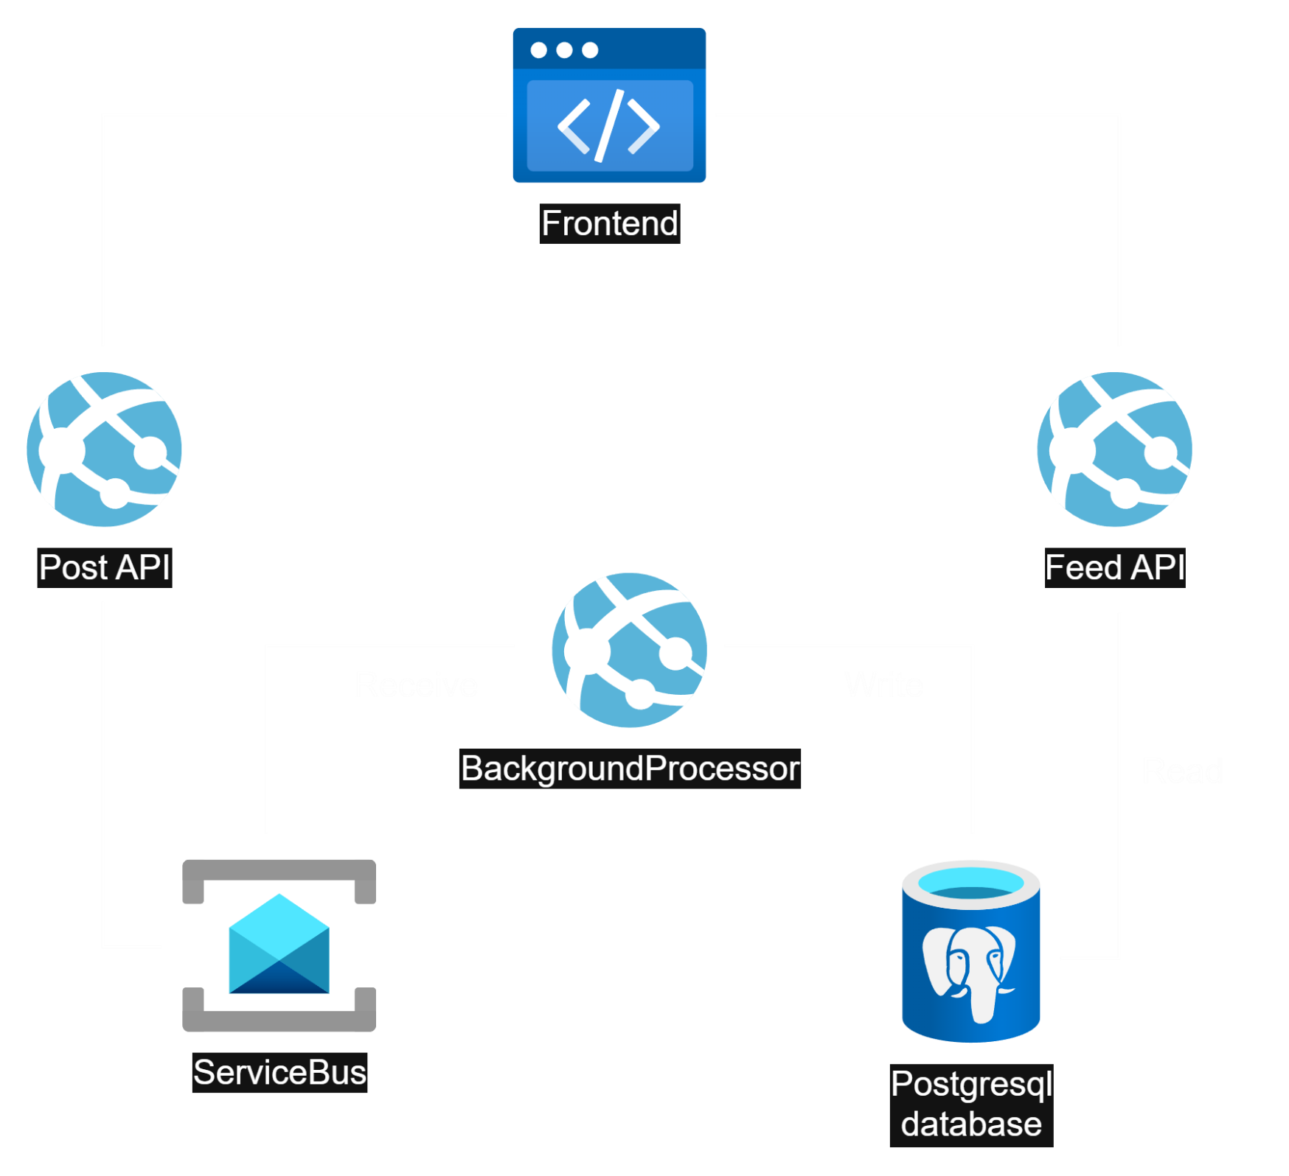
Let’s create an experiment
Notes:
Infra overview
What experiment are we going to build
- Setting up the experiment
- Running the experiment
- Background processor turned off
- Events queued in service bus
- Feed not updated

Slide 27
Why I think you should consider chaos engineering
Identify problems before an actual outage
Know how the system behaves when things go wrong
Getting confidence in the resilience of the system

Slide 28

When do you want to find out if your emergency plan works?

Slide 29
Questions?
Notes:
Demo
- Show MoneyBook application

Slide 30


m.vanarkel@4DotNet.nl www.4dotnet.nl
Thank you!
Code and slides
https://www.linkedin.com/in/martijn-van-arkel/

